Slide 1
ISA and uArch
Oleg Ladin
14 September 2020

Slide 2
Reminder: Layers of Abstraction
Application
Application
Algorithms
Algorithms
Software (SW)
Programming Language
Programming Language
Computer Science
(CS)
Operating System
Operating System
Instruction Set Architecture
Instruction Set Architecture
HW/SW interface
Microarchitecture
Microarchitecture
Gates/Register-Transfer
Gates/Register-Transfer Level (RTL)
Hardware (HW)
Electrical Engineering
(EE)
Circuits
Circuits
Physics
Physics

Slide 3
ISA and uArch
Instruction Set Architecture (ISA) is a precise definition of:
computer instructions and features
mechanisms like procedures, interrupt/exception handler, etc.
some structures
An agreement between a programmer and an engineer:
It’s all programmer needs to program machine
It’s all hardware designer needs to design machine
Microarchitecture (uArch) is Hardware implementation of ISA
Organization and features of Hardware that support everything in ISA

Slide 4
ISA and uArch
What a typical ISA defines
Data Formats. (Integer, Floating Point, Vector/Packed)
Instructions. (Operations, encoding, etc.)
Registers and Memory Organization.
Interrupts, exceptions, and traps.
Implementation-Dependent Features. (Memory control, custom features.)
What a typical uArch defines (not included into ISA)
Memory hierarchy organization (caches, buses, etc.)
Pipeline (forwarding, branch prediction, etc.)
Out-of-order executions … and many others.
they change the state
the programmer-visible state

Slide 5

Example: MIPS
An example of a RISC ISA (reduced instruction set computer).
Designed for easy programming and implementation.
Short and simple, but fast instructions → programs are larger than others, but IPC is higher.
The main aim was to take advantages of pipelined execution
Pipeline was not specified in ISA, but ISA developers tried to simplify its implementation in uArch.
Implementations:
The first one is R2000 (1986)
Later: R3000A (PlayStation), VR4300 (Nintendo⁶⁴), R4000 (PSP), R5900 (PlayStation 2)
Currently it is widely used in high-performance embedded systems, like MobileEye
One moment MIPS seemed to be overcome Intel IA-32...
It didn’t happen because Intel’s uArch was significantly better and could compensate the drawback of IA-32

Slide 6

Example: RISC-V
Pronounced “risk-five”
Another example of a RISC processor
Designed to fix MIPS design errors:
Well-defined instruction subsets
No obsolete instructions
Royalty-free
Implementations and toolchains are designed in universities
Potentially #1 competitor to ARM in microcontroller markets

Slide 7
Example: IA-32 and x86-64
An example of CISC ISA (complex instruction set computer)
Designed for laconic code and simpler assembler programming
Most of CISC advantages are not important now
Became de-facto standard in 90-2000s because of Intel CPU quality
Incrementally extensions: MMX, SSE, AVX etc.
Polished toolchains and documentation

Slide 8
Data Formats
In the memory all including data and program code is presented as binary numbers:
Data representation:
Sizes: 8-b Bytes, 16-b Half words, 32-b words, 64-b double words
Formats: signed/unsigned integer, signed/unsigned floating point
0000 0010 | 0011 0010 | 0100 0000 | 0010 0000
=
=
0x2012620
add $t0, $s1, $s2

Slide 9



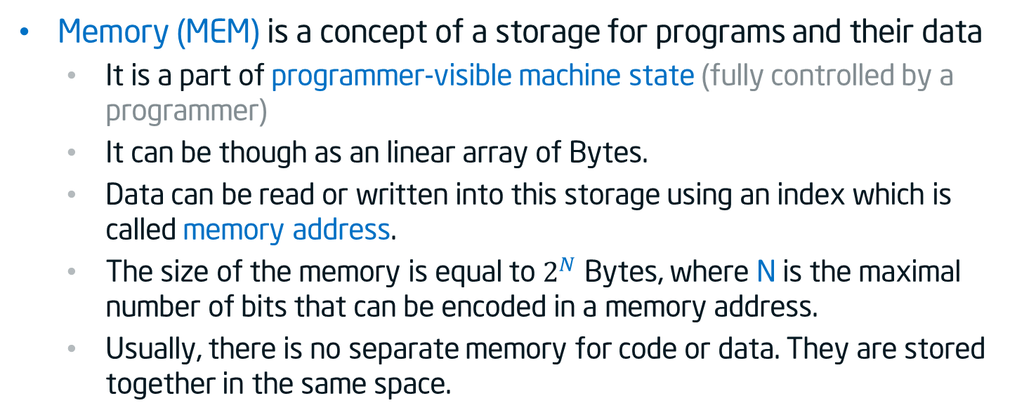
Memory addressing
Memory (MEM) is a concept of a storage for programs and their data
It is a part of programmer-visible machine state (fully controlled by a programmer)
It can be though as an linear array of Bytes.
Data can be read or written into this storage using an index which is called memory address.
The size of the memory is equal to $2^{N}$ Bytes, where N is the maximal number of bits that can be encoded in a memory address.
Usually, there is no separate memory for code or data. They are stored together in the same space.
0
1
2
$$2^{N−2}$$
$$2^{N−1}$$
$$2^{N}$$
…
00100100
…
…
…
…
…
8 bits = 1 Byte

Slide 10

Big and Little Endian
Historically numbers are being written from the right to the left (the most significant digit is on the left):
However, we enumerate elements in an array (and most other things) from the left to the right:
The question: if we put a value of two bytes (e.g. 256) at the beginning of the array where the most significant byte will be? In element 0 or element 1?
Decimal 537 = 7*${\text{10}}^{0}$ + 3*${\text{10}}^{1}$ + 5*${\text{10}}^{2}$
Decimal 537 = 7*${\text{10}}^{0}$ + 3*${\text{10}}^{1}$ + 5*${\text{10}}^{2}$
Binary 1101 = 1*${\text{2}}^{0}$ + 0*${\text{2}}^{1}$ + 1*${\text{2}}^{2}$ + 1*${\text{2}}^{3}$
Binary 1101 = 1*${\text{2}}^{0}$ + 0*${\text{2}}^{1}$ + 1*${\text{2}}^{2}$ + 1*${\text{2}}^{3}$
0
1
2
$$2^{N−2}$$
$$2^{N−1}$$
$$2^{N}$$
…
…
…
…
…
…
…

Slide 11
Big and Little Endian
The answer: it depends on the endianness of the ISA
Most significant byte
Least significant byte
Decimal 256 = Binary 0000 0001 | 0000 0000
Decimal 256 = Binary 0000 0001 | 0000 0000
Decimal 256 = Binary 0000 0001 | 0000 0000
15
8
7
0
0
1
2
0
1
2
Big Endian
Little Endian
00000001
00000000
00000000
10000000
15
8
0
7
7
0
8
15
Most of the modern ISAs are little-endian: x86, RISC-V (has BE/Bi)

Slide 12
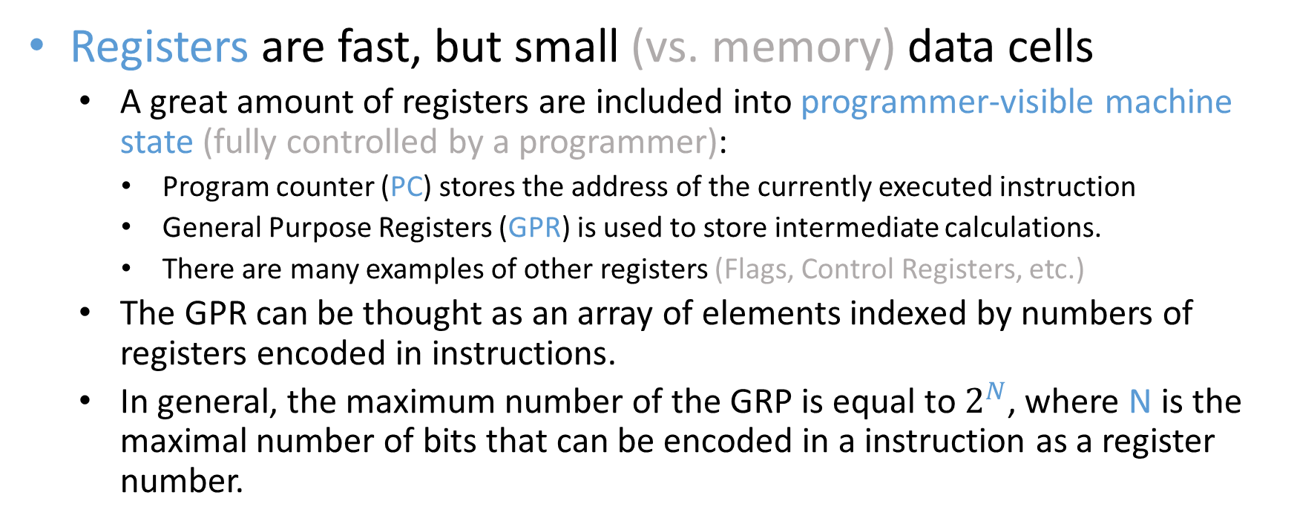
Registers
Registers are fast, but small (vs. memory) data cells
A great amount of registers are included into programmer-visible machine state (fully controlled by a programmer):
Program counter (PC) stores the address of the currently executed instruction
General Purpose Registers (GPR) is used to store intermediate calculations.
There are many examples of other registers (Flags, Control Registers, etc.)
The GPR can be thought as an array of elements indexed by numbers of registers encoded in instructions.
In general, the maximum number of the GRP is equal to $2^{N}$, where N is the maximal number of bits that can be encoded in a instruction as a register number.

Slide 13
Basic RISC operations
Move: set a register to constant value or value of other register
Load: move a value from memory/IO to register
Store: move a value from register to memory/IO
Arithmetic: addition, subtraction, multiplication, division
Logic: conjunction, disjunction, negation, exclusive disjunction
Comparison: equal, not equal, less, greater, less than etc.
Direct unconditional branch: jump directly to some code
Direct conditional branch: jump to some code conditionally (if/then)
Indirect branch: read address from register and jump to it (switch/case, returns)
System calls: call for resource managements by OS

Slide 14
Summary
What a typical ISA defines:
Data Formats: bit width, endianness
Registers and memory organization
Instructions — ‘rules’ to change registers and memory
Interrupts, exceptions, system calls, and traps.
But what does uArch define?
We’ll discuss it as soon as we look to the lower CS levels — gates, circuits, physics

Slide 15
Acknowledgements
These slides contain material developed and copyright by:
Krste Asanovic (MIT/UCB), CS152-L1
David M. Koppelman (LSU), EE4720-L1

Slide 16
Literature
Computer Organization and Design: The Hardware/Software Interface, Patterson D.A., Hennessy J.L., 3rd Edition (Eng) — the main book for this course. It contains all that you need to know about the computer architecture and MIPS ISA.
Computer Architecture: A Quantitative Approach, Hennessy J.L., Patterson D.A., 4th Edition — the classic book about state-of-the-art high-performance computing microarchitectures.

Slide 17
Thank You

